Slide 1
Pneumonoultramicroscopicsilicovolcanokoniosis
I I I I I I I
lung beyond small-viewing silicon volcano dust disease

Slide 2
Affixes

Slide 3
Prefixes (pre = before, fix = attached)
A-, ab- = away, from (absent, abduct, avert)
Ad- = to, toward, in addition (adduce, advertise)
    Assimilation: ac-, af-, ag-, al-, an-, ap-, ar-, as-, at-
Ante- = before (antecedent, antediluvian)
Circum- = around (circumnavigate, circumstance)
Com- = with, together; [intensive]: completely, very
    Con-, cor-, col-, co-
Contra- = against, opposite (contradict)
De- = down, away, aside, out, off (deduct, deposit)
Dis- = apart, away, not (dismiss, dissimilar)
E-, ex- = from out, forth (educe, emit, exit)

Slide 4
Prefixes (pre = before, fix = attached)
In- = in, into, on, upon, against (invent, encircle)
    Im-,il-, en-, em- (empower)
In- = not, un- (incorrigible, immortal)
Inter- = between, among (intermittent, interregnum)
Intro- = within, in (introduce, introspect)
Ob- = toward, opposite, against (obstacle)
    Oc-, of-, op-
Per- = through (pervade, permit, perfect)
Post- = after (postpone, postscript)
Pre- = before, in front (preposition, precede)
Pro- = before, in front, forth, out, instead of, for

Slide 5
Prefixes
Re-, red- = back again (reduce, reconvene)
Se- = without, apart (secure)
Sub- = under; secretly (submarine, subvocalize)
Super- = over, above (superposed, superb)
Trans- (tra-) = across, over (transmit, transfer, traduce)

Slide 6
Taumatawhakatangihangakoauauotamateapokaiwhenuakitanatahu
“The summit where Tamatea, the man with the big knees, the climber of mountains, the land-swallower who traveled about, played his nose flute to his loved one.”

Slide 7
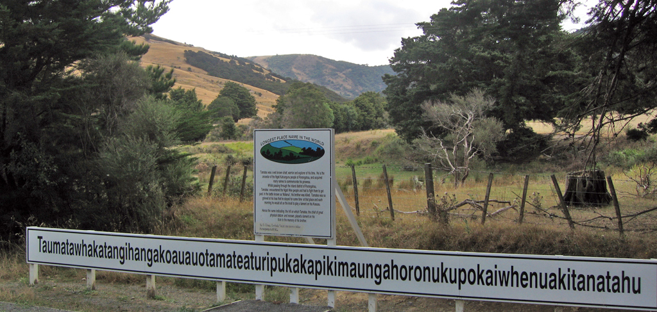

Slide 8
Caedo = -cise-
Capio = -capt-, -cept-
Cedo = -cess-
Claudo = -clude-
Dico = -dict-
Duco = -duct-, -duce-
Facio = -fact-, -fect-
Fero = -fer-
Flecto = -flex-, -flect-
Frango = -fract-
Iacio = -ject-
Lego = -lect-
Mitto = -miss-
Plico = -plicat-
Pono = -posit-
Porto = -porta(t)-
Premo = -press-
Scribo = -scribe-, -script-
Specio = -spec(t)-
Sto = -sta(t)-
Traho = -tract-
Venio = -ven(t)-
Verto = -vert-, -vers-

Slide 9
 | 4 | 3 | 2 | 1
Content (x2) | 20+ words, Actual derivatives | 14-19 words, 2-3 nonderivative | 10-13 words, Multiple nonderivative | 0-9 words, Multiple nonderivative
Readability | All words are clear | Near perfect: few stray letters, smudges | Generally legible but misspelling, smudges, etc. | WHAT DOES IT SAY???
Aesthetics | Paper is crisp, color added, neatly spaced, imaginatively portrayed | Paper is crisp, color added, neatly spaced | Lacks one of the criteria listed to the left | Paper wrinkled or worse, pencil only

Slide 10
Derivative Quiz
A | B
1. ad- | 5. re-
2. ab- | 6. trans-
3. ex- | 7. inter-
4. per- | 8. –or, -er
9. Flagro means “to burn.” What does conflagration mean?
To stand before a firing squad b) An intense fire
Swollen d) An arsonist
10. Corrigo means “to straighten.” What does incorrigible mean?
a) Difficult to deal with b) Excessively devoted to a wife
c) Marked by impatience d) Not able to be corrected

