Slide 1
Wheelock Chapter 20
4th Declension Nouns

Slide 2
4th Declension (Masculine/Feminine)
 | Singular | Plural
Nominative | -us | -ūs
Genitive | -ūs | -uum
Dative | -uī | -ibus
Accusative | -um | -ūs
Ablative | -ū | -ibus

Slide 3
4th Declension (Neuter)
 | Singular | Plural
Nominative | -ū | -ua
Genitive | -ūs | -uum
Dative | -ū | -ibus
Accusative | -ū | -ua
Ablative | -ū | -ibus

Slide 4
Recall
Declensions are identified by genitive endings
A noun-adjective combo may agree in number, gender, and case but not look alike
E.g. frūctus dulcis (sweet fruit), manus mea (my hand)

Slide 5
Ablative of Place from Which
Includes a verb of motion and a preposition (ab, dē, ex = away from, down from, out of)
Graecī ā patriā suā ad Italiam nāvigāvērunt.
Flūmen dē montibus in mare flūxit.

Slide 6
Ablative of Separation
Shows separation (not movement)
Verbs like “to free,” “to lack,” and “to deprive” often have ablative of separation
Eōs timōre līberāvit.
Agricolae pecūniā saepe carēbant.
Notes:
Sometimes a preposition, sometimes not

Slide 7
Practice (ID the ablative, translate)
Cornua cervum ā perīculīs dēfendunt. (cervus, -ī = stag)
Oedipūs duōbus oculīs sē prīvāvit. (prīvāre = to deprive)
Multī ex agrīs in urbem venient.

Slide 8
Translate; identify ablatives
Iste commūnī sēnsū caret.
Senectūs nōs prīvat omnibus voluptātibus.
Nūllus accūsātor caret culpā; omnēs peccāvimus.
Nūlla pars vītae vacāre officiō potest.
Prīma virtūs est vitiō carēre.
Discēde nunc ex hāc urbe cum malā manū scelerātōrum.

Slide 9
Practice
Montēs frūctibus carēre videntur.
Ego genū illīus sinistrā manū pulsavī.
Lībera nōs servitūte.
Istī coniūratī ab urbe prohibērī nōn possunt.
Corpus discessit, sed spīritus remanet.
Odī.

Slide 11
Review Practice
Magnō metū mē līberābis, sī omnēs istōs coniūrātōs tēcum ēdūcēs.
Istī coniūrātī ab urbe prohibērī nōn possunt.
Pater pecūniam ex Graeciā movēre coepit.

Slide 12
Wh. 20 Vocabulary Quiz
A | B
1. genu, genūs | 5. prohibeo, prohibere…
2. metus, metūs | 6. discedo, discedere
3. dexter, dextra, dextrum | 7. cornu, cornūs
4. odī, odisse, osurum | 8. senatus, senatūs
9. Provide a derivative from column A.
10. Provide a derivative from column B.

Slide 13
Wh. 20 Grammar Quiz
Decline AND TRANSLATE metus, metūs.
Decline cornu, cornūs.
Translate; identify types of underlined ablatives.
Iste commūnī sēnsū caret.
Corpus discessit, sed spīritus remanet.
Magnō metū mē līberābis.
Odī.
Flūmen dē montibus flūxit.

Slide 14
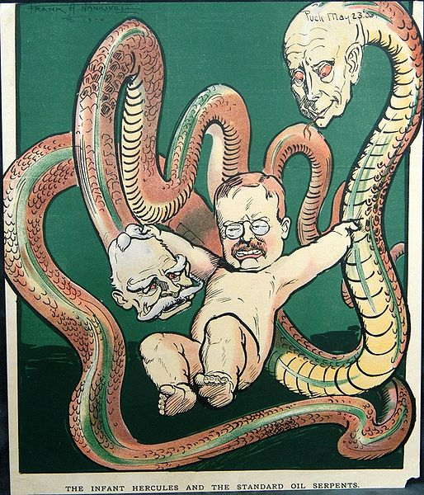

Slide 15
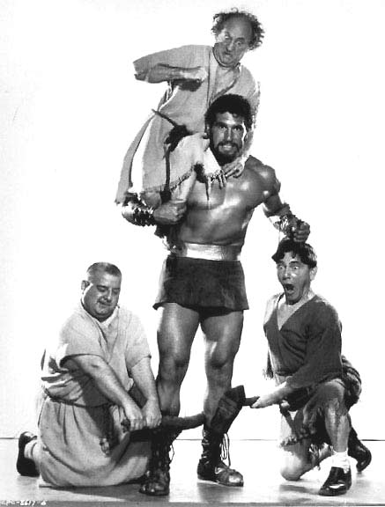
The Three Stooges Meet Hercules -- 1962

Slide 16
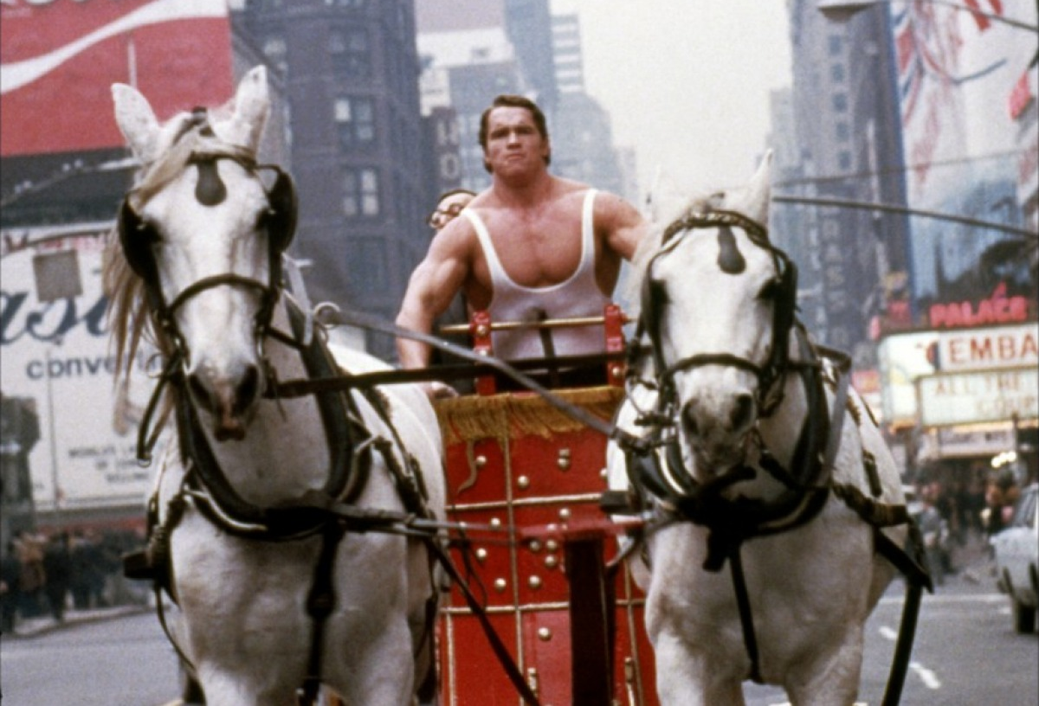
Hercules in New York -- 1970

Slide 17
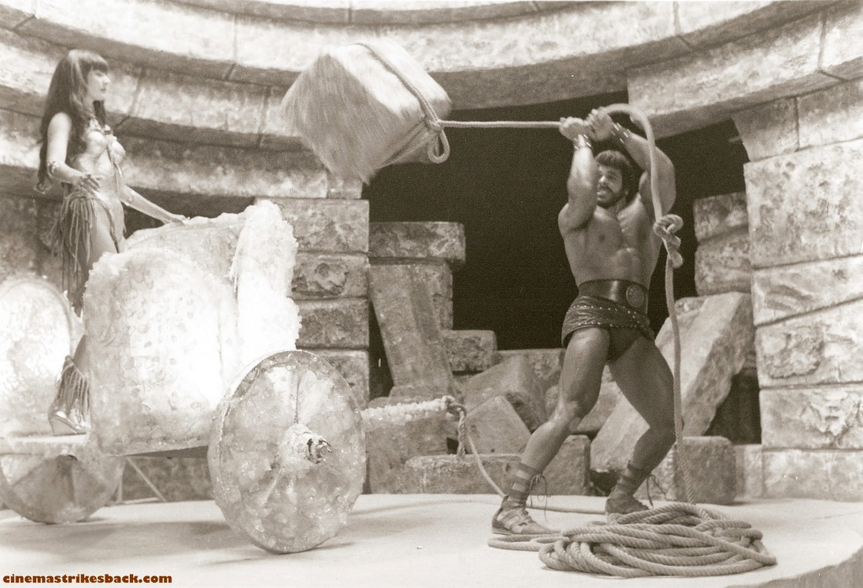
Hercules -- 1983

Slide 18
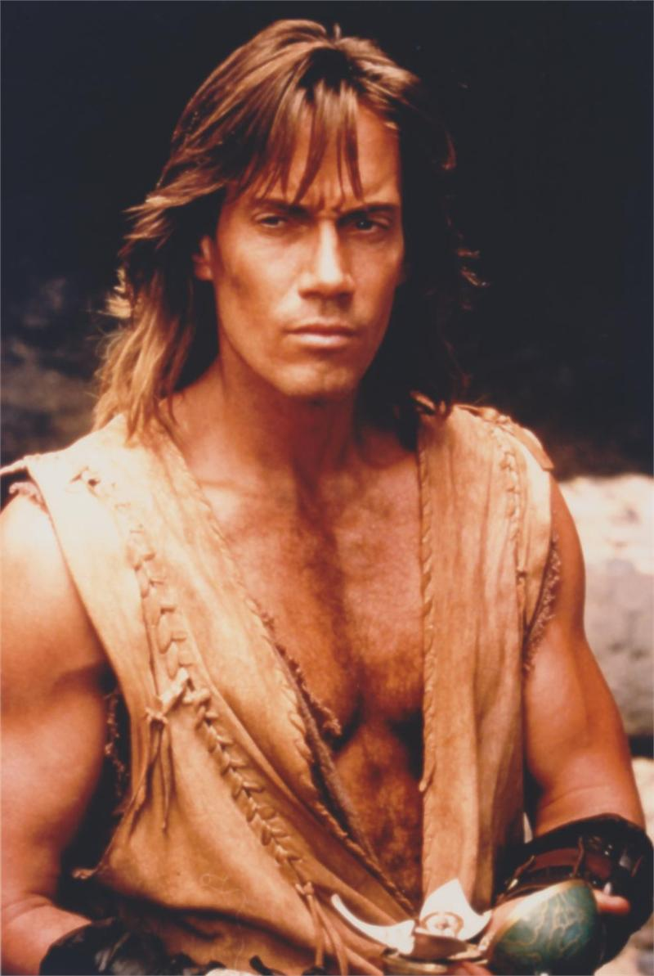
Hercules: The Legendary Journeys – 1995-1999

Slide 19
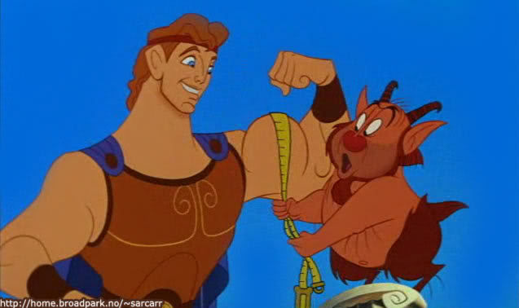
Hercules -- 1997

Slide 20
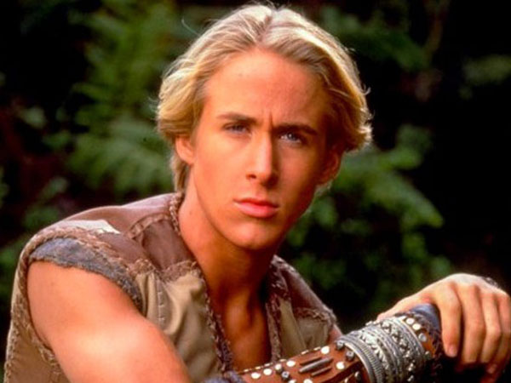
Young Hercules -- 1998

