Slide 1
Greek and Roman Government

Slide 2
Greek Forms: Tyranny
Each polis led by a turannos (ruler)
Lycurgus of Sparta
One of the great law-givers depicted in the U.S. House of Representatives
Focused on equality, military fitness, and austerity
Draco
Thrasybulus and Periander
Periander asks Thrasybulus how to deal with rivals
Notes:
Thrasybulus (de Miletus), Periander (de Corinth), Draco (de Athens)

Slide 3
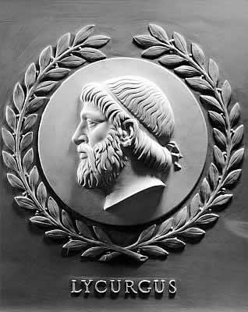
Notes:
U.S. House of Representatives

Slide 4
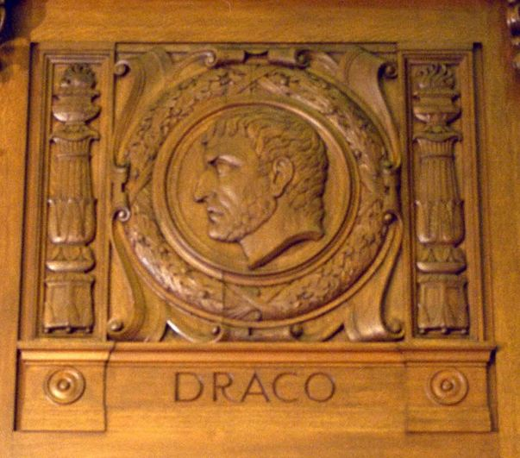
Notes:
Library of the Supreme Court

Slide 5
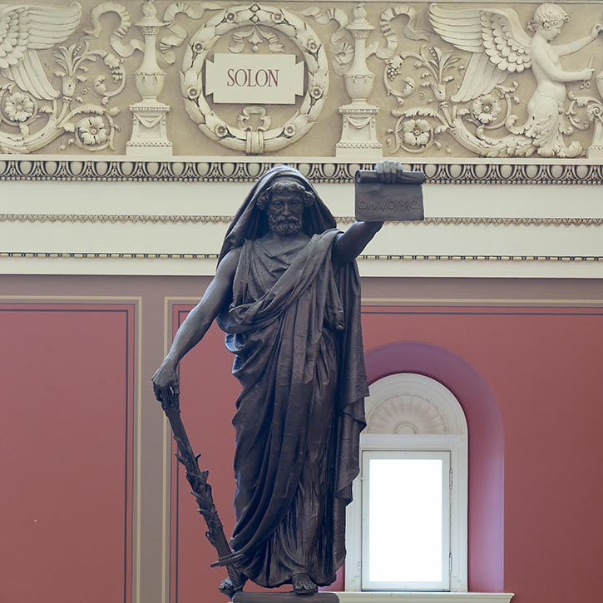

Slide 6
Solon of Athens
Elected as archon of Athens in 594 B.C.
Reforms:
Cancels all debts, forgiving his own debtors of 5 talents
Establishes a national coinage with weight verification
Trade regulations to feed own people (except olives)
Leaves
Statue in Library of Congress
Notes:
Talent (9 years of skilled labor… ish… depending on the time… and place… and whether it’s silver or gold)

Slide 7
Athenian Democracy
Δημοκρατια = demos (people) kratos (rule)
After Solon, Pisistratus becomes tyrant; Hipparchus is assassinated; Hippias is expelled.
Cleisthenes establishes democracy in 508 B.C.
Direct democracy
Arbitrary divisions of city called Demes
Assembly: show up in demes and vote
Council of 500 (boule)—chosen by lot, serve for one year, frequently rotating leadership

Slide 8
Roman Government
Monarchy (753 – 509 B.C.)
Republic (509 B.C. – 27 B.C.)
Empire (27 B.C. – 1423 A.D.)

Slide 9
Res publica (the public thing)
Senatus Populusque Romanus

Slide 10
Roman Republic
Cursus Honorum (Course of Honors/Offices)
Military
10 years of military service OR
Military Tribune: 24 men around age 20; commanded legion
Quaestor
Oversaw treasury; must be at least 30 years old
Aedile
Supervisor of public works (food/water, buildings, games); must be at least 36 years old and have held the office of Quaestor
Praetor
Judge; must be at least 39 years old
Consul
Two elected men at least 40 years old; executive power

Slide 11
More terms
Imperium: power to command
The aediles, praetors, and consuls had imperium in varying degrees
Dictator
6 month term, appointed by Senate in times of crisis
Could pass acts/laws that did not need to be ratified
Imperium AND could deliver capital punishment within Rome
Veto (literally, “I forbid”)
Each magistrate could veto anyone below him
The consuls could veto each other

Slide 12
Senate
Senatus consultum: official advice from the Senate
Allocated military resources
Anyone in the cursus honorum was automatically a senator
Senators serve for life (unless impeached)
Led by princeps senatus and then ex-consuls
Unpaid

Slide 14
Tribune of the Plebeians
Designed to protect the common people
Only had power in Rome itself
It was a capital offense to harm a Tribune, disregard his veto, or interfere with him
Tribune could veto any act
Provocatio

