Slide 1
Origins of Rome

Slide 2
Aeneas flees Troy
Barocci, 1598

Slide 3
Birth of Twins
Numitor – King of Alba Longa
Amulius - Brother to the King
Rhea Silvia – Daughter of King Numitor
Mars, God of War – as himself

Slide 4
Romulus and Remus

Slide 5
Founding the City
Lupa, woodpecker, and shepherds
Augury (Romulus wants to found of Palatine, Remus on the Aventine)
Building the wall
-So perish every one that shall hereafter leap over my wall
Romulus gives his name to Rome
Traditional year: 753 B.C.

Slide 6
Early Rome
- Populated by criminals - Sabine women
Notes:
Bureau of Prisons, as of July 2013—93.3% male inmate population

Slide 7
Review
Why did Amulius force Rhea Silvia to become a Vestal Virgin?
What is the traditional date of the founding of Rome?
Who birthed the c0-founders of Rome?
For whom is Rome named?
Who killed Remus and why?

Slide 8
7 Kings of Rome
Romulus (753 – 715 B.C.)
Rape of the Sabine Women
Formed a senate to advise the king
Formed a class system
Expanded boundaries
Disappearance/Death/Deification?
Notes:
Disappeared after offering sacrifice on Quirinal Hill; foul play and power grab by the Senate? Avoid suspicion by claiming he was taken up with the gods in a whirlwind and a thunderclap; becomes known as the god Quirinus; tells senators that Rome should be the capital of the world

Slide 9
7 Kings of Rome
Numa Pompilius (715 – 673 B.C.)
Bringer of peace and religion
Built the Temple of Janus
Established Vestal Virgins and Pontifex Maximus
Established boundaries
Notes:
After Romulus’ death, interregnum period of one year (senator rules for five days and switch) People decide on Numa (a Sabine) to be king, he requested an augur be summoned to divine the will of Jupiter
Boundaries: seeking to establish a lawful respect of property and to maintain peaceful relations with neighbors

Slide 10
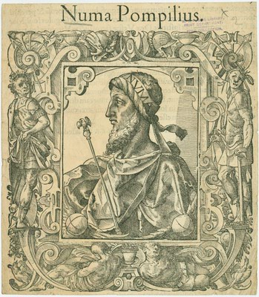
7 Kings of Rome

Slide 11
7 Kings of Rome
Tullus Hostilius (673 - 642 B.C.)
WAR!
Neglected the gods
Struck dead by lightning
Notes:
Struck with an illness for not honoring gods, tried to perform a ceremony but did it wrong, lightning

Slide 12
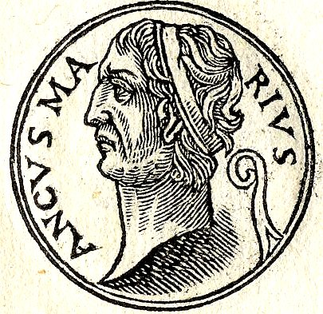
Ancus Marcius (642 - 617 B.C.)
Grandson of Numa Pompilius
Formed plebeian class
First jail, first bridge across the Tiber
Port at Ostia
Last Latin-Sabine king
Notes:
Grandson of Numa, had religious rites posted publicly so they would performed accurately; Latins thought, “Oh, it’s another peace and gods type of dude. Let’s attack.” Marcius leads war (sets up system wherein Fetials [priests] officially declare war), wins, makes Latins move into Rome on Aventine Hill (possibly forming the plebeian class)

Slide 13
Tarquinius Priscus (616 - 579 B.C.)
1st Etruscan king
Built sewers, drained the swamps
Built the Circus Maximus
Introduced the Etruscan Triumph
Added senators from conquered peoples
Assassinated
Notes:
Wealthiest man in Etruria but not able to be king because of his father’s heritage; moves to Rome with his wife (an eagle takes his hat… and puts it back!); becomes Ancus Marcius’ right hand man; gives speech winning over the plebs and claiming that a foreign king is NBD (he’d be the 3rd). Wife urges the move, interprets the eagle/hat omen, etc. Sons of Ancus Marcius arrange an assassination attempt; shepherds fake an argument, get led before the king, while one is telling his side, the other buries an axe in his head. Tanaquil (the wife) bandages it, sends away all witnesses, declares that the king is still alive and that Servius would serve as regent; Servius makes some decisions, pretends to consult the king on others… people get used to him in power, and when Tarquin’s death is announced, Servius stays

Slide 14
Lucius Tarquinius Priscus

Slide 15
Servius Tullius (579 – 535 B.C.)
Rumoured to be son of a slave
Built Servian Wall
Formed Rome’s first census
Brought socio-economics into government and military
Killed by Tarquinius Superbus
Notes:
Grew up in the palace. While sleeping, his head caught fire, and he kept sleeping (not harmful, just a divine blessing). Tanaquil talks to hubby about this, Becomes son-in-law of Targquin.
Assassinated by Tullia (his daughter) and Lucius Tarquinius (son of Priscus). BTW, the two killed their spouses so that they could marry each other. Tarquinius criticizes Servius in the Senatre for not being elected by the Senate, being slave-born, being given the throne by a woman, etc. When Servius (age ) comes to defend himself, Tarquin throws Servius down the steps of the senate, his men stab him, and Tullia drives over him with her chariot.

Slide 16
Servius Tullius

Slide 17
Tarquinius Superbus (535 – 509 B.C.)
Completed Temple of Jupiter Optimus Maximus
Purchased the Sibylline books

