Slide 1
Ancient Theater

Slide 2
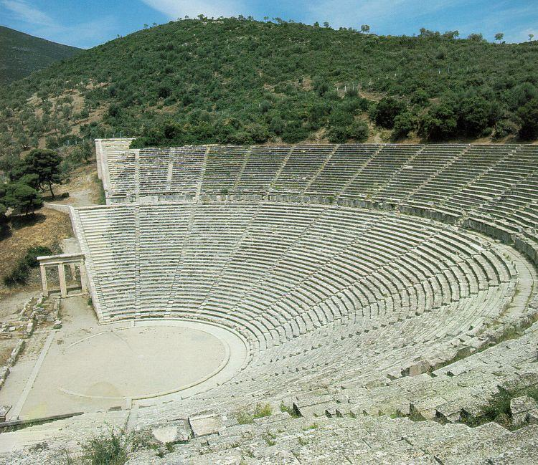
A Greek Amphitheatre at Epidaurus

Slide 3
Dionysus
Names: Dionysus, Bacchus, Līber, Iacchus, Lyaeus, the Twice-Born, etc., etc. WHY?
Raised in Dracanum? Icarus? Naxos? Thebes? Nysa, which is in Ethiopia? or Egypt? or Libya? or Arabia?
The "Stranger"
Dionysus associated with all fluids--not just wine but honey, sap, blood, etc.

Slide 4
Dionysus
English words associated with Dionysus' worship:
Enthusiasm = "in God" (i.e. a god in you)
Ecstacy = "I stand out" (standing outside of self)
Catharsis = "purging"
Maenads/Bacchae (part of fantasy)
-women (usually) who get drunk, chase animals down, rip them apart, and eat their raw flesh, ingesting their spirit... Mmm... Mmm... good!
Notes:
1: a god inside of you, 2:

Slide 5
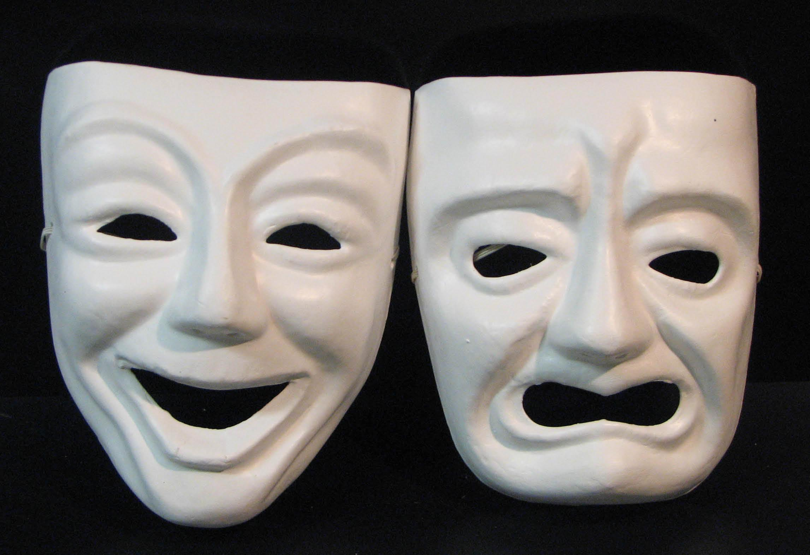
Greek Drama

Slide 6
Greek Tragedy
Theater begins as a big festival to open new wine (a celebration/ritual for Dionysus)
Tragedy = τράγος + ᾠδή ("goat song")
Quickly becomes a competition
  big money spent for a writer to produce a series of three tragedies

Slide 7
Greek Tragedy (via Aristotle's Poetics)
Aristotelian Terminology:
"Tragedy is a representation of a serious, complete action which has magnitude, in embellished speech, ... by people acting and not by narration, accomplishing by means of pity and terror the catharsis of such emotions."

Slide 8
Greek Tragedy (via Aristotle's Poetics)
Aristotelian Terminology:
plot--structure of incidents
  best if a reversal of fortune
character
  should be moral and noble with a tragic flaw (hamartia)
3-5. Thought, Diction, Melody
6. spectacle (least important, furthest removed from the playwright)

Slide 9
Greek Tragedy (via Aristotle's Poetics)
Aristotelian Unities:
Unity of Action--play should follow one main action with few or no subplots
Unity of Place--the stage should represent one location (without compressing geography)
Unity of Time--the action in a play should take place within a 24-hour period

Slide 10
Famous Greek Tragedians
Aeschylus
  Oresteia trilogy, Seven Against Thebes, Prometheus Bound
Sophocles
  Oedipus trilogy, Electra
Euripides (didn't win a lot, but we have a lot of his stuff)
  Medea, Trojan Women, Iphigenia in Aulis, The Bacchae*
    *won posthumously
Aristotle: "Sophocles portrays people as they should be; Euripides shows people as they are."
Notes:
Euripidean realism

Slide 11
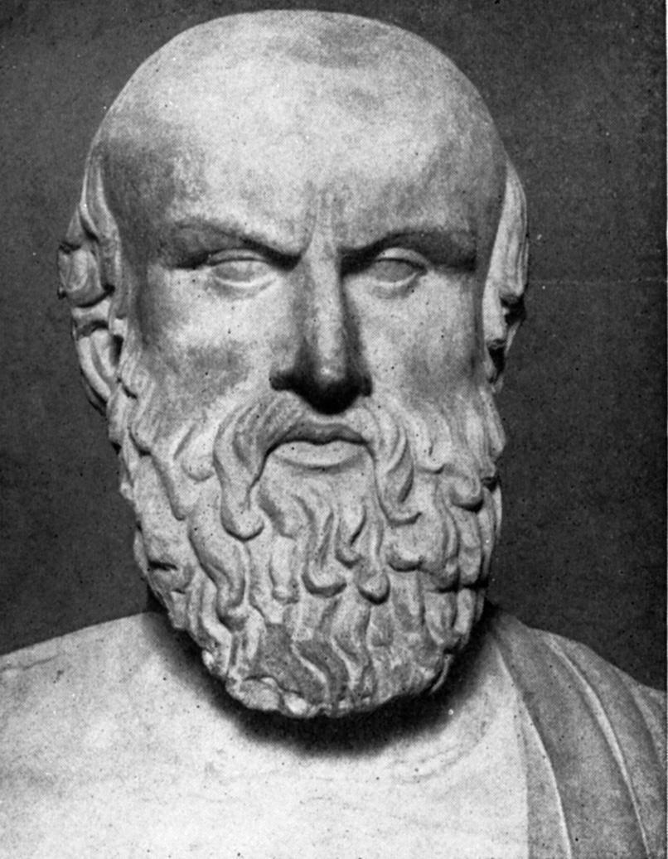
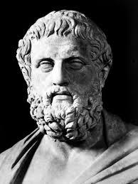
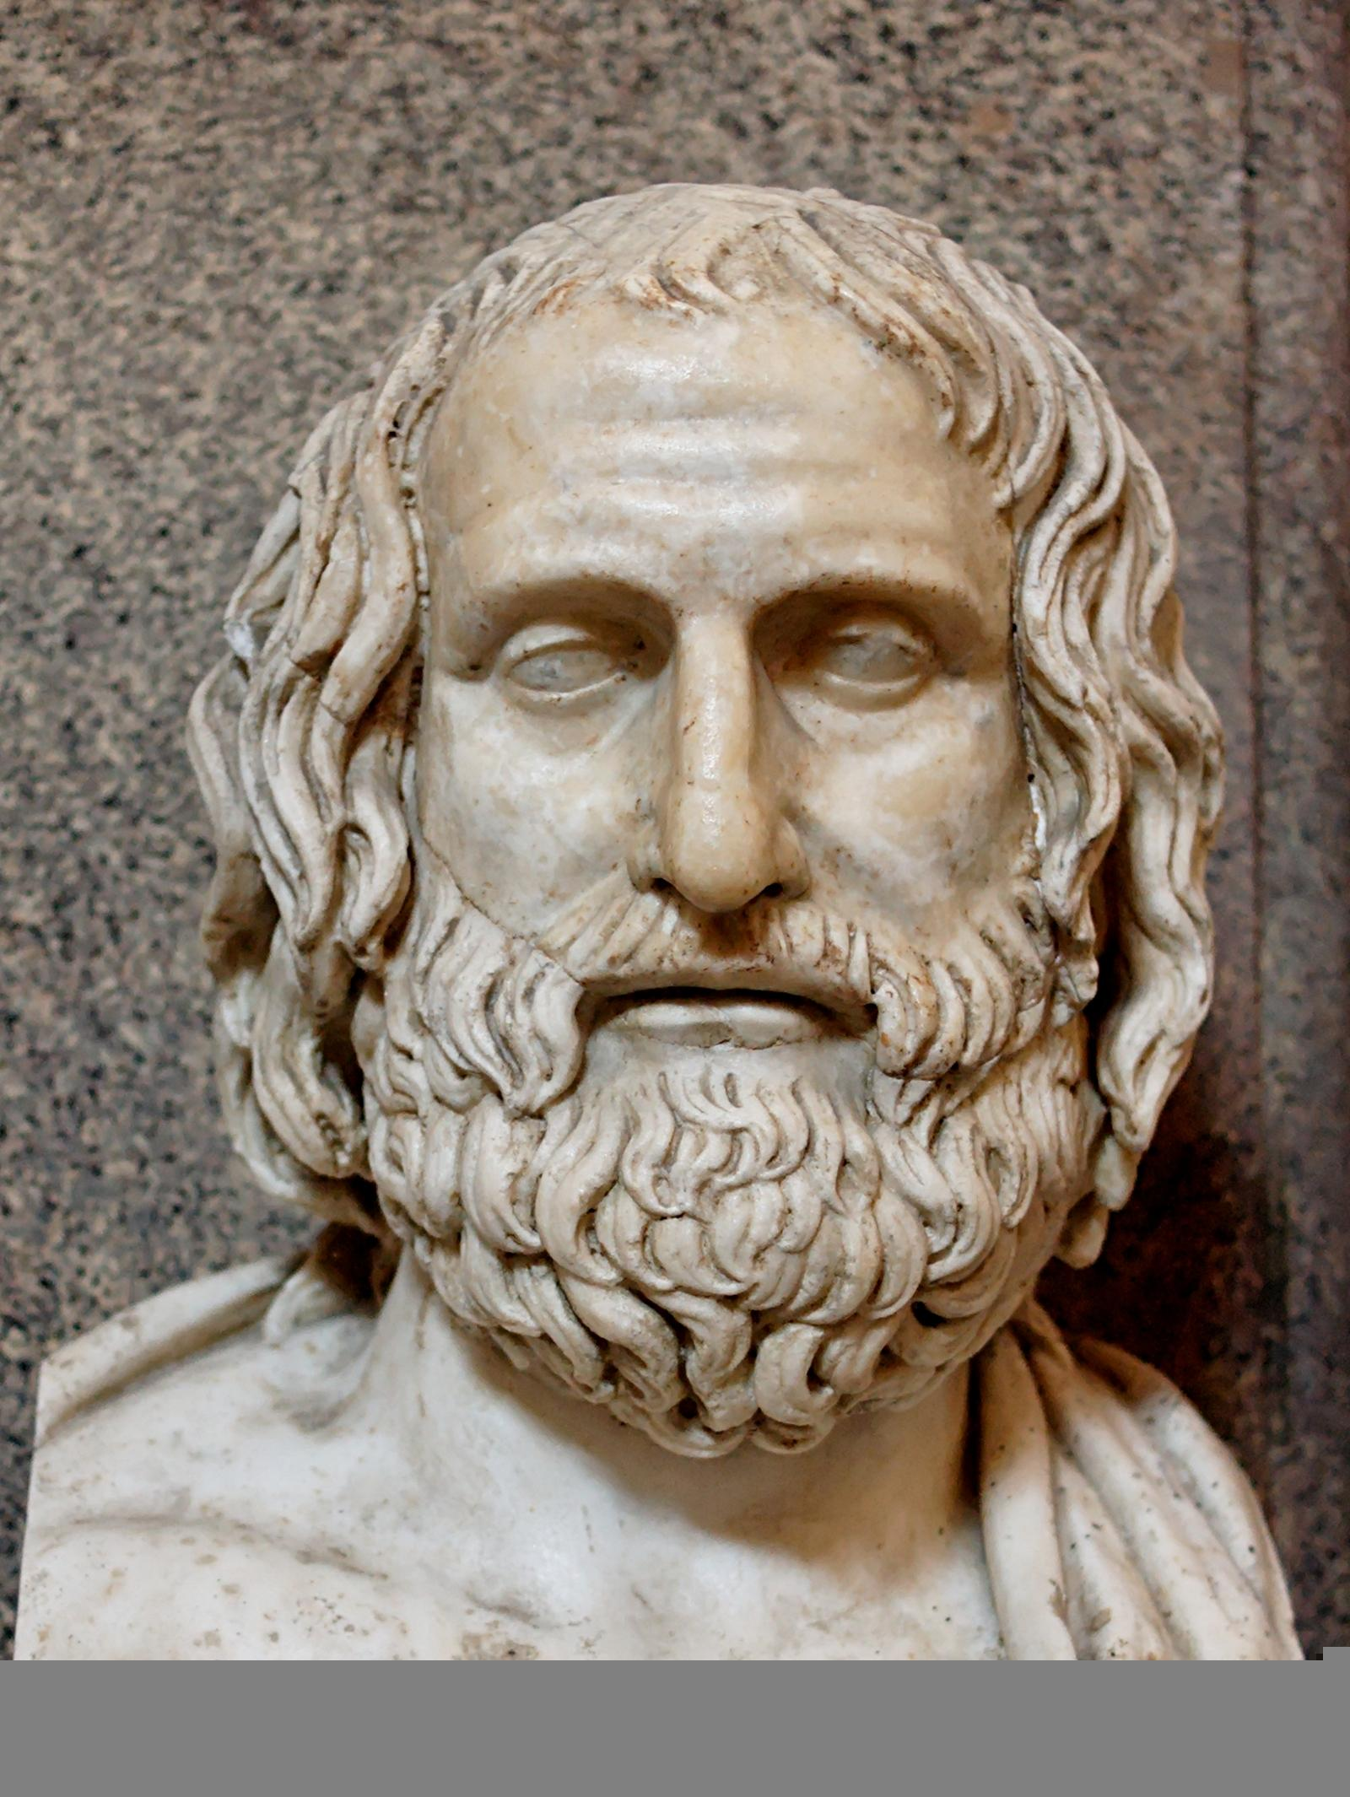
Aeschylus Sophocles Euripides

Slide 12
Greek Comedy
What is a comedy?
Famous Comic Playwright:
Aristophanes: Lysistrata, The Frogs

Slide 13
Form of the Greek Theater
Chorus with 1, 2, or 3 actors
Masks
Mechane and Deus ex machina
Contests (the playwright's full trilogy would be presented in one day)

Slide 14
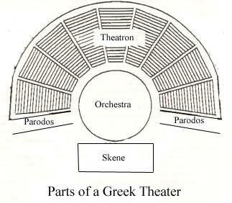

Slide 15
Parts of a Greek Theater
Orchestra: circular "dancing space" for the chorus, sometimes containing an altar
Theatron: "viewing place" where audience sits
Skene: ("tent") building behind the stage, decorated as a palace, temple, etc. with doors
Paradoi: "passageways" which chorus, messengers, and audience members used to exit/enter

Slide 17
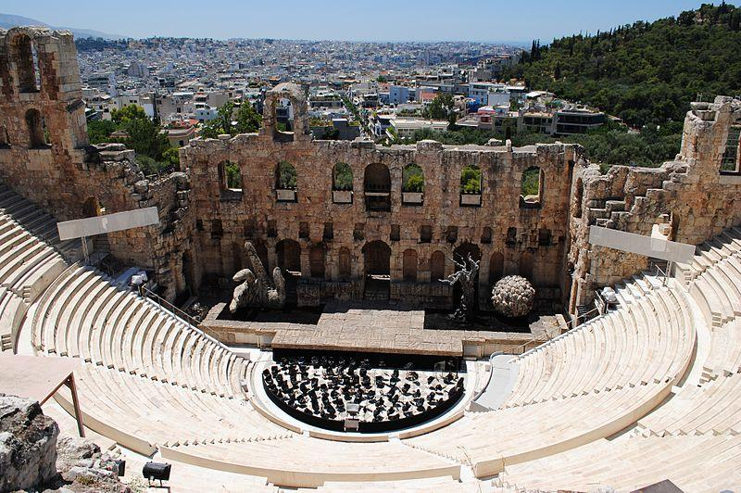
Odeon of Herodes Atticus (Athens)

Slide 18
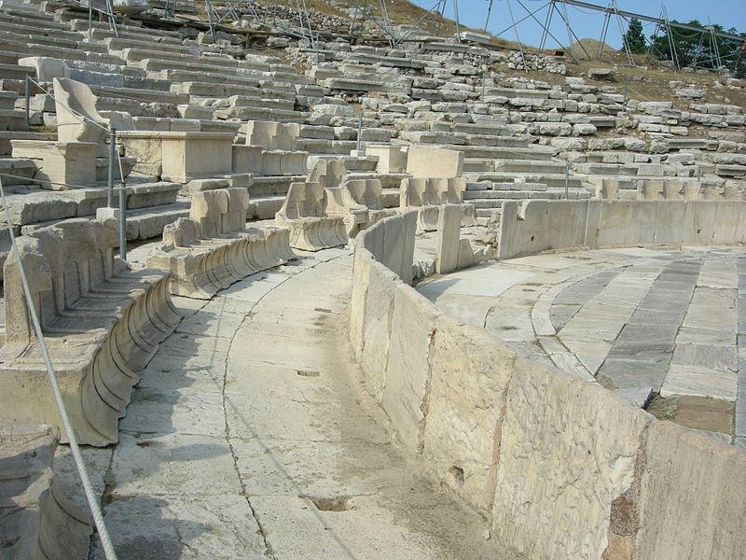
Theatre of Dionysus (Athens)

Slide 19
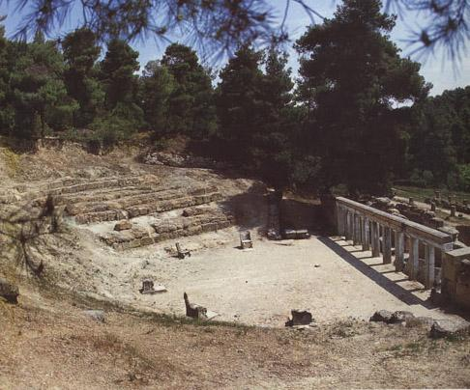
Theatre of Oropos

Slide 20
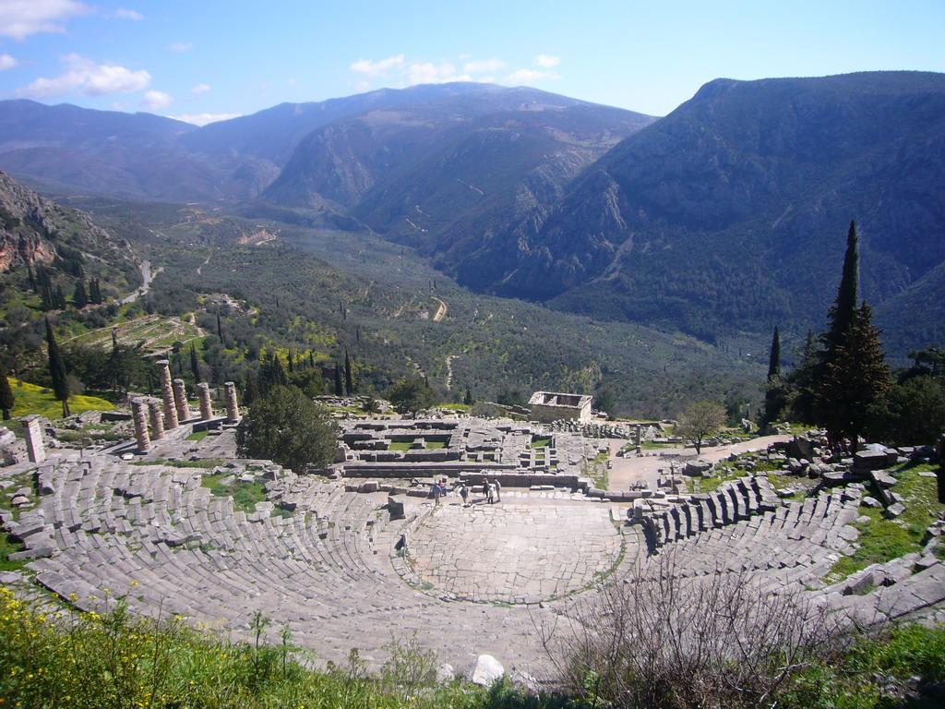
Theatre of Delphi, Phocis
Notes:
*Notice: for Greeks, a picturesque background was a high priority

Slide 21
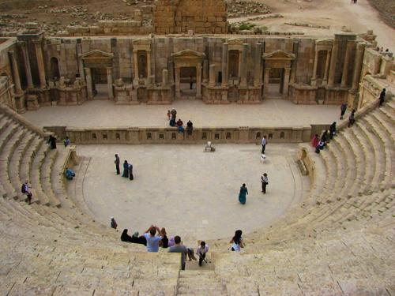
Roman Theatre at Jerash

Slide 22
Roman Theatre
It took Rome until 240 B.C. to catch on.
Romans eliminated the chorus and added music over dialogue
Yes, there were a few notable writers (Seneca the Younger, Terence, Plautus), but I want you to understand stock characters.

Slide 23
Stock Characters in Roman Comedy
adulescens--the young, rich, love-struck hero who requires assistance and is the son of senex
senex--too strict or too soft father; often in love with the same woman as his son but never succeeds and is often dragged away by an angry wife
leno--an amoral, money-loving brothel owner (who often owns the adulescens' love interest)
Notes:
stock character--a stereotypical, instantly recognizable character

Slide 24
Stock Characters in Roman Comedy
miles gloriosus--the arrogant soldier
servus callidus--the clever slave, often talkative and loyal to the adulescens
uxor or matrona--she loves her children but is temperamental toward her husband
virgo--love interest of the adulescens; she is virtuous and beautiful but has little personality
Notes:
Actually, identifiable by their costume as well

Slide 25
 | 9-10 | 7-8 | 6 | 0
Background info | 2+ page report clearly outlining how the play fits Aristotelian definitions | 2+ page report outlining how tragedy fits Aristotelian definitions | 1.5-2 page report that makes an effort to explain the tragedy | “I wrote my name on a paper and turned it in.”
Time | 10-14 minutes | 8-10 minutes | 7-8 minutes | Under 7 minutes
Accuracy/Elements of Greek Theater | Follows plot, includes elements | Follows plot with some imprecision | Follows plot with imprecision | It follows the plot as well as World War Z followed the book
Quality | Well-prepared; clear audio/visual | More than 5% of dialogue is muddled; adequate visuals | More than 15% of dialogue is muddled; poor visuals

